Slide 1
CS 295A/395D: Artificial Intelligence
LTL Applications
Prof. Emma Tosch
4 April 2022

Slide 2
Logistics
Reminders:
Worksheet due Friday in class
Remember: option to peer grade; must be in class to swap
Programming assignment out
When running into issues, please post questions on Teams!

Slide 3
Agenda
LTL
Review syntax and semantics
Model Checking
Binary Decision Diagrams
Applications of LTL
Brief discussion of CTL/CTL*

Slide 4
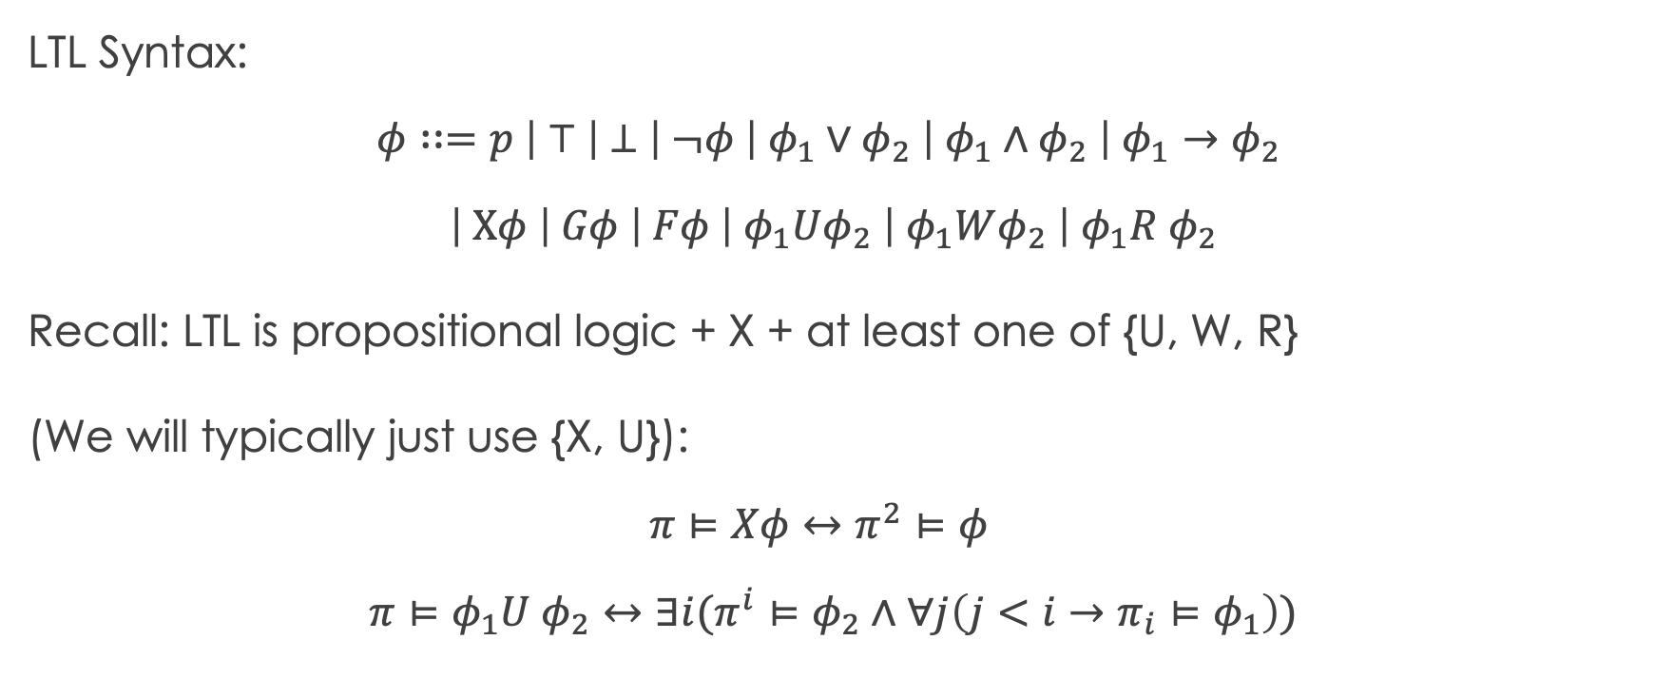
Recall: LTL Syntax
LTL Syntax:
$$φ∷=p \left| ⊤ \left| ⊥ \right| ¬φ \right| φ_{1}∨φ_{2} \left| φ_{1}∧φ_{2} \right| φ_{1}→φ_{2}$$
$$\left| Xφ \right| Gφ \left| Fφ \right| φ_{1}Uφ_{2} \left| φ_{1}Wφ_{2} \right| φ_{1}R φ_{2}$$
Recall: LTL is propositional logic + X + at least one of {U, W, R}
(We will typically just use {X, U}):
$$π⊨Xφ↔π^{2}⊨φ$$
$$π⊨φ_{1}U φ_{2}↔∃i(π^{i}⊨φ_{2}∧∀j\left(j<i→π_{i}⊨φ_{1}\right))$$

Slide 5
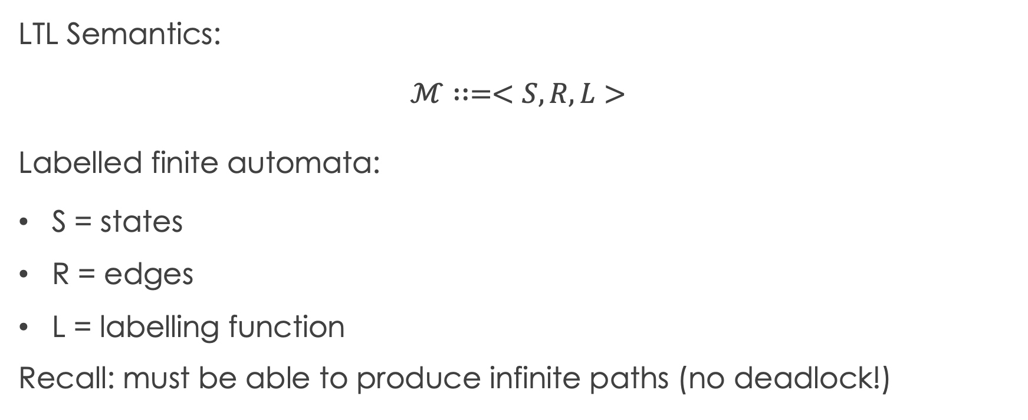
Recall: LTL Semantics
LTL Semantics:
$$ℳ∷=<S, R, L>$$
Labelled finite automata:
S = states
R = edges
L = labelling function
Recall: must be able to produce infinite paths (no deadlock!)

Slide 6
LTL Syntax and Semantics
LTL
Review syntax and semantics
Model Checking
Binary Decision Diagrams
Applications of LTL

